Slide 1

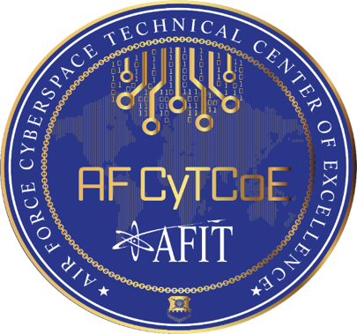


Multi-Domain Operations and Cyber Education Innovation
AFCEA Rocky Mountain Cyberspace Symposium
Maj Rich Dill, Capt Nathan Flack, Lt Jacob Orner
“Tell me and will forget. Teach me and I may remember. Involve me and I will understand.” -- Benjamin Franklin

Slide 2
Disclaimer
The views expressed are those of the individual instructors and do not necessarily reflect the official policy or position of the Air Force, the Department of Defense, or the U.S. Government.

Slide 3
Optional Survey (Side A)

Slide 4

MDC2 Card Game Trailer

Slide 5

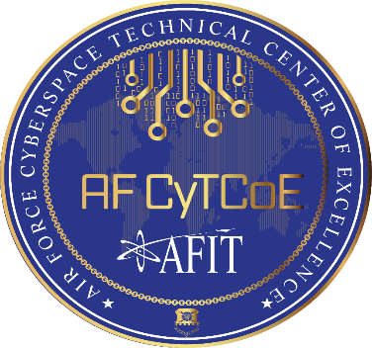
Air Force Cyberspace Technical Center of Excellence
Maj Rich Dill, PhD
Ops Director, Cyber Technical Center of Excellence (CyTCoE)

Slide 6
How do you learn?
“I do not teach anyone I only provide the environment in which they can learn” – Albert Einstein

Slide 7
Charter Overview
AF CyTCoE Charter (SecAF & CSAF, 2007):
Enhance AF ability to develop cyber warriors capable of delivering strategic, operational and tactical effects by leveraging the most cutting-edge technologies and tactics available.
1. Develop relationships with various cyber orgs/communities (AF, DoD, fed agencies, civilian academic/commercial research orgs)
2. Maintain awareness of what these various cyber orgs/communities are doing
3. Use this knowledge to feed into the needs of our operational cyber forces
4. Work closely with AF, DoD and national organizations to synergize efforts in this field

Slide 8













Organizational Layout
Director and Chancellor
AFIT
School of Systems and Logistics
AFIT/LS
Graduate School of Engineering & Management
AFIT/EN
School of Strategic Force Studies
AFIT/EX
The Civil Engineer School
AFIT/CE
Comp &Elec
ENG
Sys
ENG
Physics
Math &
Stat
Ops
Science
Aero &
Astro ENG
Autonomy & Navigation Technology
Cyber Operations
Directed Energy
Tech Intel Studies & Research
Ops Analysis
Scientific Test & Analysis
Space Research & Assurance
Cyber activity across all of AFIT

Slide 9



AFIT Cyber Mission Areas
Education
Graduate degree programs
Professional Continuing Education
Attack, defend, exploit, manage, analyze, optimize…
Technology research
Defense focused
Basic, theoretical & applied
Classified / unclassified
State, national and international partnerships
NSA/DHS Center of Academic Excellence in Cyber Defense Research

Slide 10
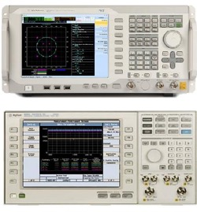
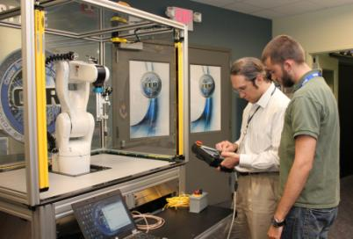
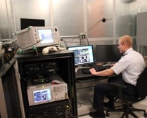
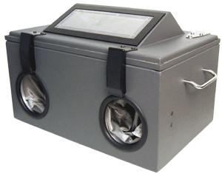

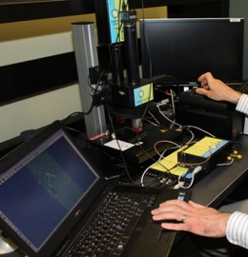
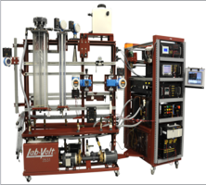
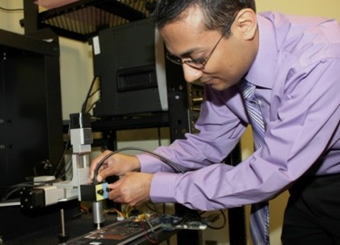
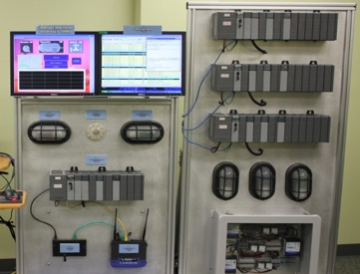
Research Lab & Network Support
Radio Frequency Analysis Chamber
Wireless Security Research
Hardware / Software Reverse Engineering
Embedded Systems
Critical Infrastructure Protection (CIP)

Slide 11
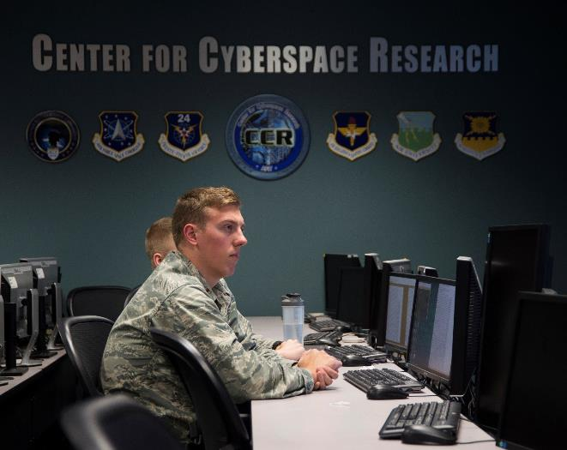
Cyber Defense Network

Slide 12

Cyber Education Hub
Online delivery platform to offer micro modules of cyber education and training – think Netflix of cyber education
Initially a research project
Discover benefits and pitfalls of natively developing in the cloud
Optimize delivery for maximum benefit to user
Will contribute to the greater CoL
Ultimately will provide platform for Air Force community to learn and understand cyber dependencies related to missions across the spectrum

Slide 13
The Cyber Education Hub™
AFCEA Rocky Mountain Cyberspace Symposium
Lt Jake Orner

Slide 14
Agenda
Current Challenges
Getting Airmen up to Speed with Cyber
Cyber Education Hub
Gamification
Skill Trees
Future Work

Slide 15
Current Challenges
Scalability and Breadth Problem
Currency Problem
Complexity Problem

Slide 16
Current Challenges (Cont.)
Scalability and Breadth Problem
Need more non-cyber experts to have cyber understanding
Understand the systems and the risk to systems in their career field
Shifting priorities from “protect everything” to “mission assurance” and “resilience”
Current education is either too technical or too generic for broader community engagement
Little or no examples of scenarios that equate to people’s lives

Slide 17
Current Challenges (Cont.)
Currency Problem
Information and operational technology is inherently disruptive
Traditional methods of updating content no longer keeping pace

Slide 18

Current Challenges (Cont.)
Complexity Problem
Some cyber topics require a significant understanding of foundational concepts
Traditional education includes prerequisite courses
Imparts lengthy time requirements which may dissuade enrollment

Slide 19
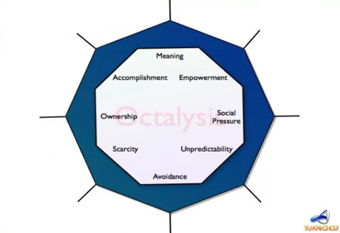
Research
How to modernize cyber education & training?
Use elements from popular commercial products
Increase Engagement, Motivation, Enjoyment
Human-Focused Design vs Function-Focused Design
Ease STEM learning curve

Slide 20
Cyber Education Hub
Cloud-based platform
Self-ownership of education and training
Consume and publish targeted cyber content
Different depths
Community tailored
Videos, papers, blogs, briefings, external content, etc.
“Byte Size Learning” (Airman’s Magazine Article)
“Rethinking USAF Cyber Education & Training,”
International Conference on Cyber Warfare and Security (2018)

Slide 21

Cyber Education Hub
Addresses challenges of Scalability, Currency, and Complexity
Cloud Technology - available to all Airmen
Different experiences and career fields will ensure consumers have most current perspective that relates to them at a level they can understand
Modularizing content allows only what is needed to be found and digested by consumer

Slide 22



Cyber Education Hub (Cont.)
Employs strategies similar to Netflix, YouTube, etc.
Tailored to military environment
Not a replacement for Learning Management Systems
Blackboard, Udacity, edX, etc.
Exploration of content vs forced learning
No intent to automate evaluation
No mandate to use

Slide 23
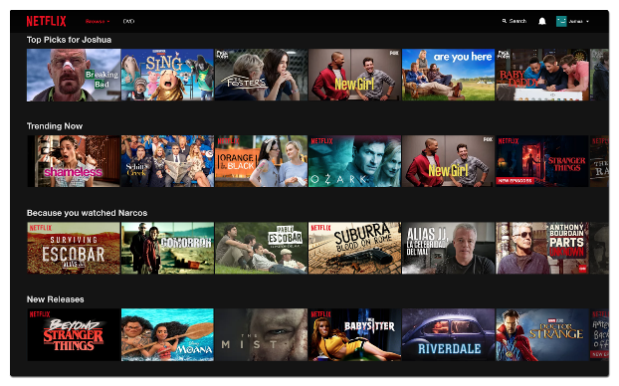
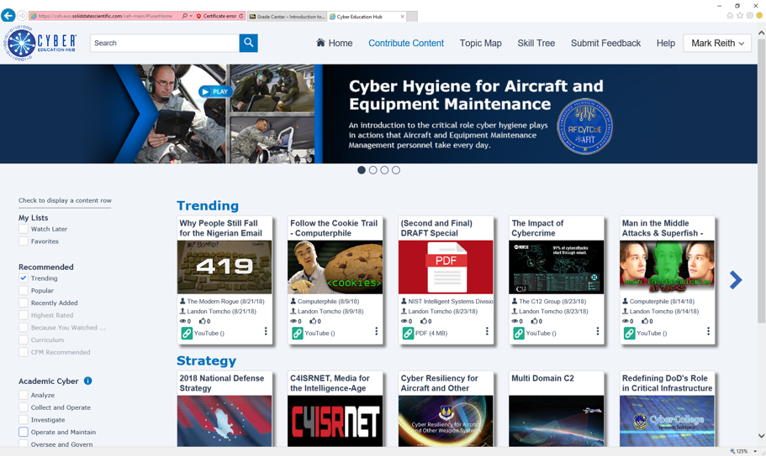
Association: Netflix

Slide 24
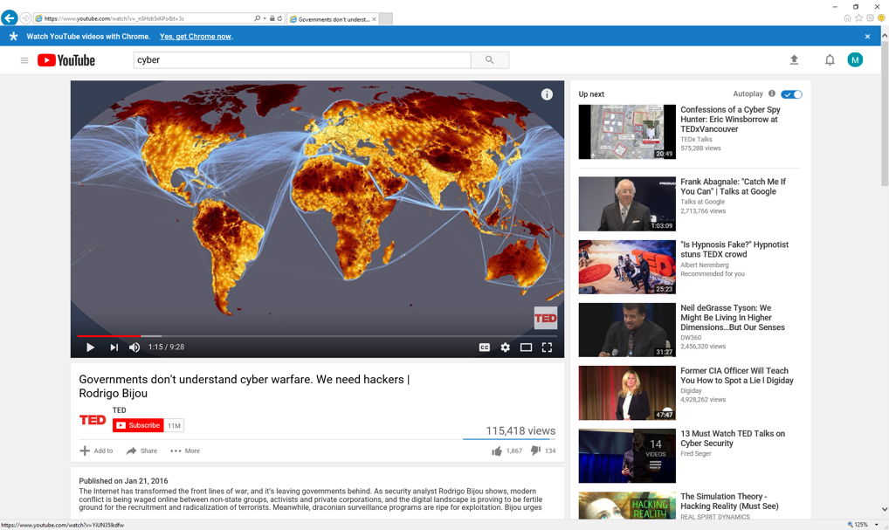
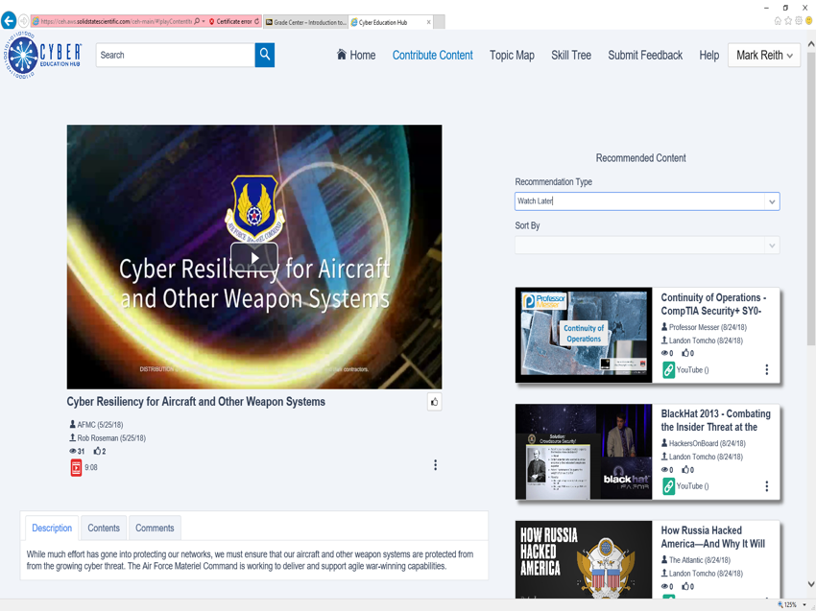
Association: YouTube

Slide 25



What is Gamification?
The use of game mechanics and experience design to digitally engage and motivate people… (Gartner Inc.)
The use of game elements and game-design techniques in non-game contexts (Werbach, Hunter)
The craft of deriving all the fun and addicting elements found in games and applying them to real-world or productive activities. It is a design process that optimizes for the human in the system, as opposed to pure efficiency of the system
“Human-Focused Design” vs “Function-Focused Design.”

Slide 26
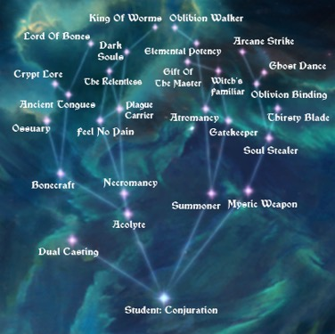
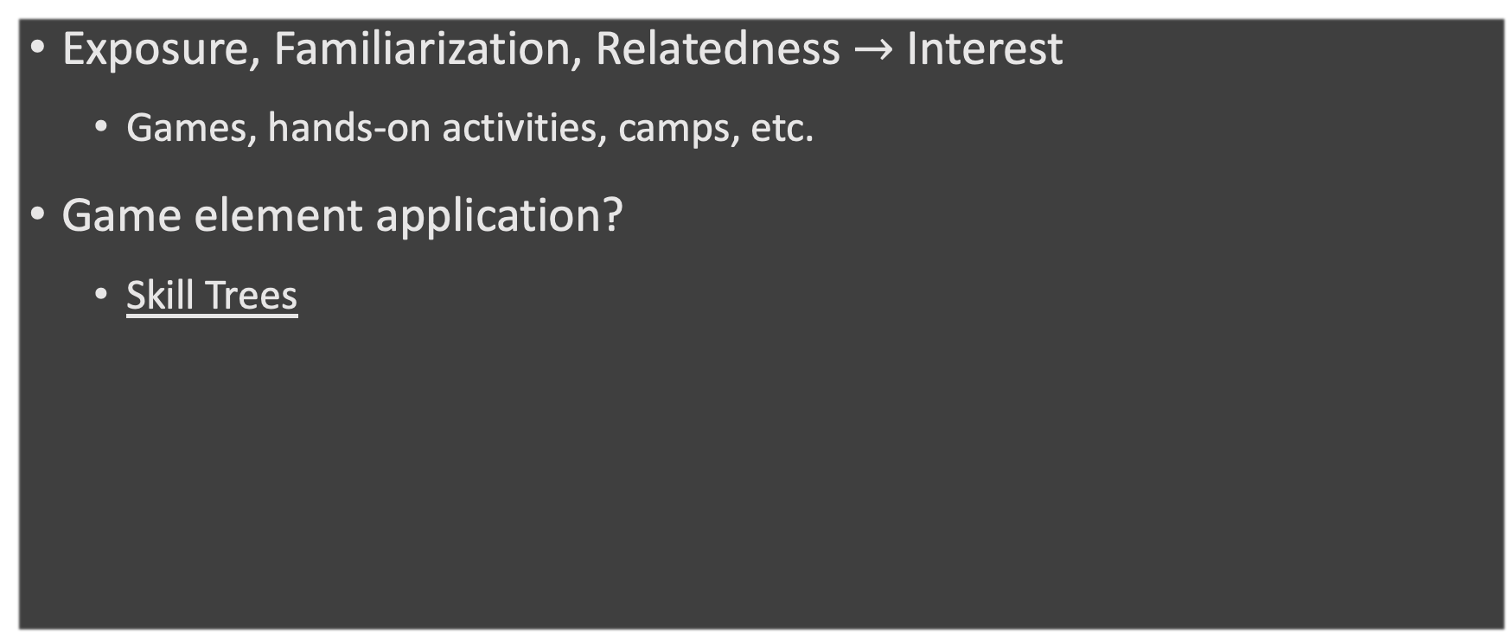
How?
Exposure, Familiarization, Relatedness $→$ Interest
Games, hands-on activities, camps, etc.
Game element application?
Skill Trees

Slide 27

Explore
Connect to the Cyber Education Hub
www.afit.edu/ceh

Slide 28

Registration

Slide 29
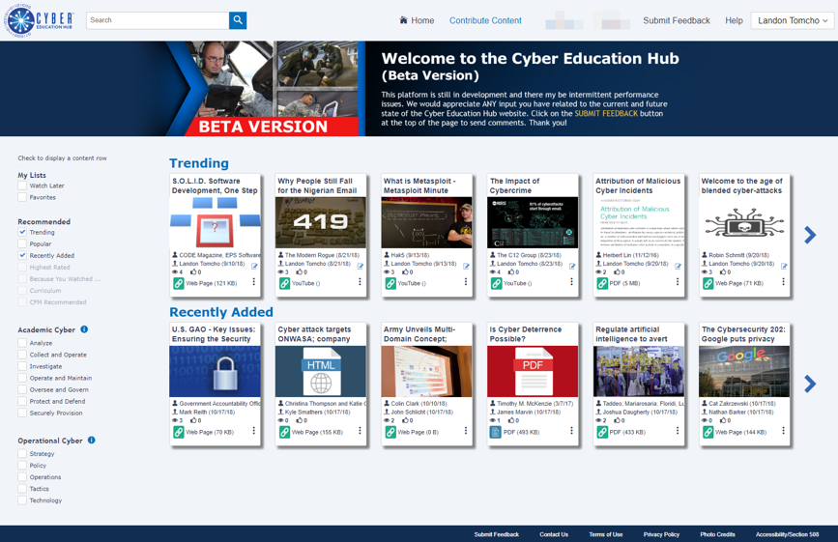

Slide 30
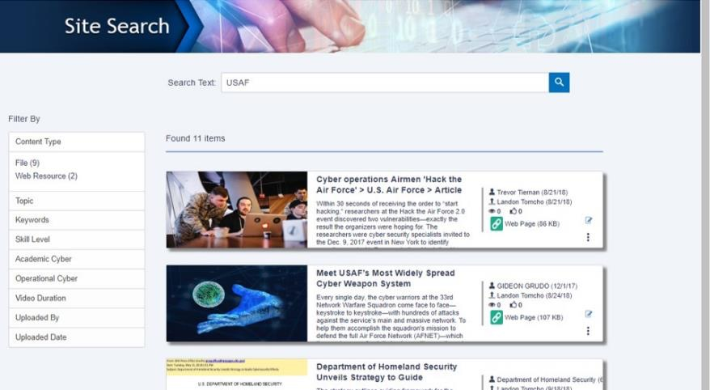

Slide 31
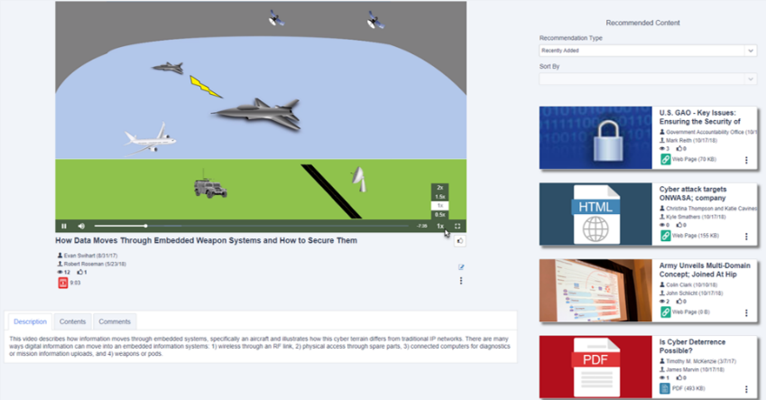

Slide 32
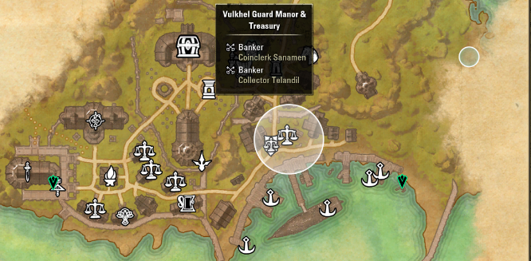
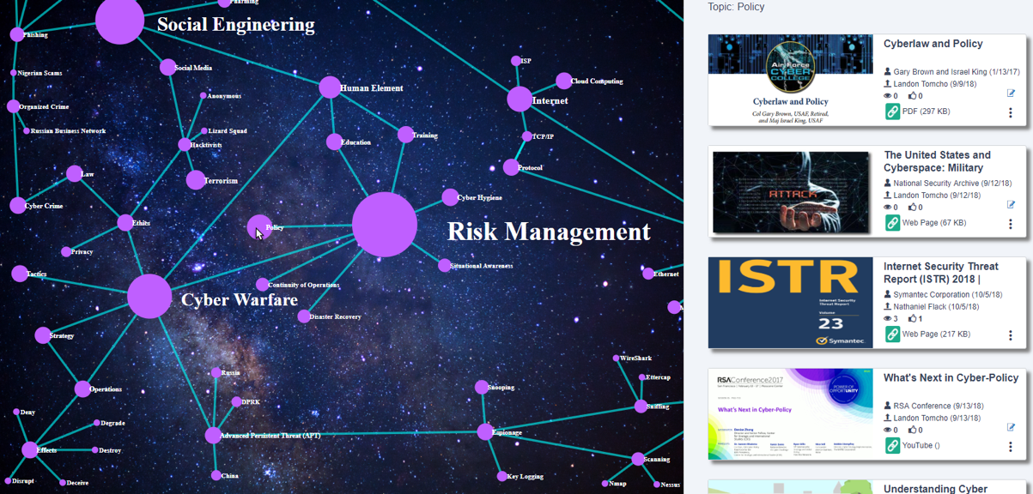
Gamification: Topic Maps
Orientation
Information
Navigation
Autonomy
Click Topic
See Content

Slide 33
Skill Trees
Most sites either have:
Classic linear prerequisite content flow (Udemy, Khan Academy)
Content laid out with little/no organization (YouTube, MilTube)
Skill Trees can:
Show relationships between Content
Provide Direction AND Autonomy
Be tailored to an individual or community

Slide 34

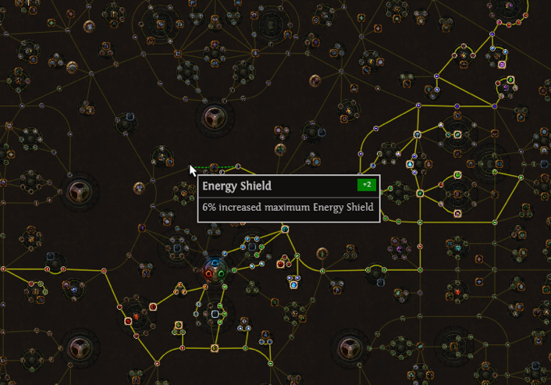
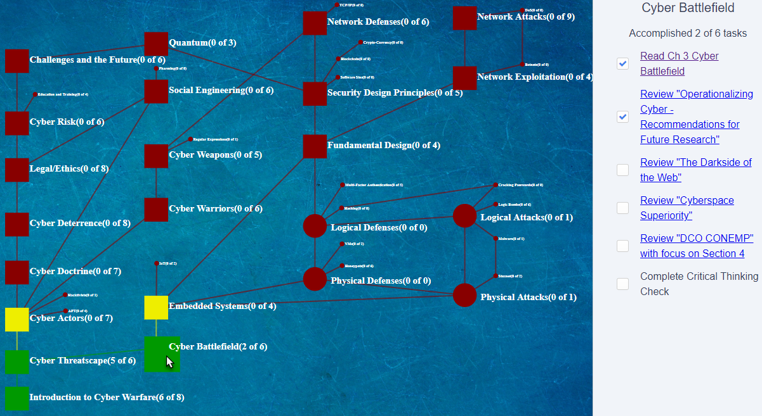
Gamification: KSA Trees
Unlock Skills
Level Up
Complete Challenges
Increase Knowledge, Skills, Abilities

Slide 35
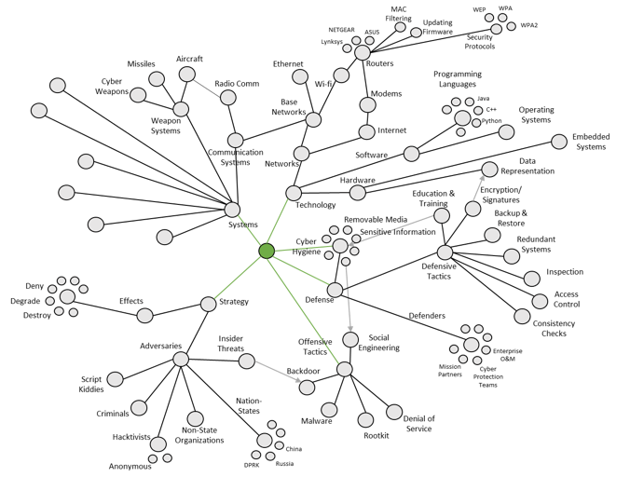
Mock AF Cyber Tree

Slide 36
Future Work
Monitoring and Analysis of game elements on Hub
Best way to release the platform
What type of content is best for different demographics, personalities, etc.
Reward system in Cyber Education Hub
Skill Trees and application to more educational fields and also other occupations

Slide 37
Questions?

Slide 38
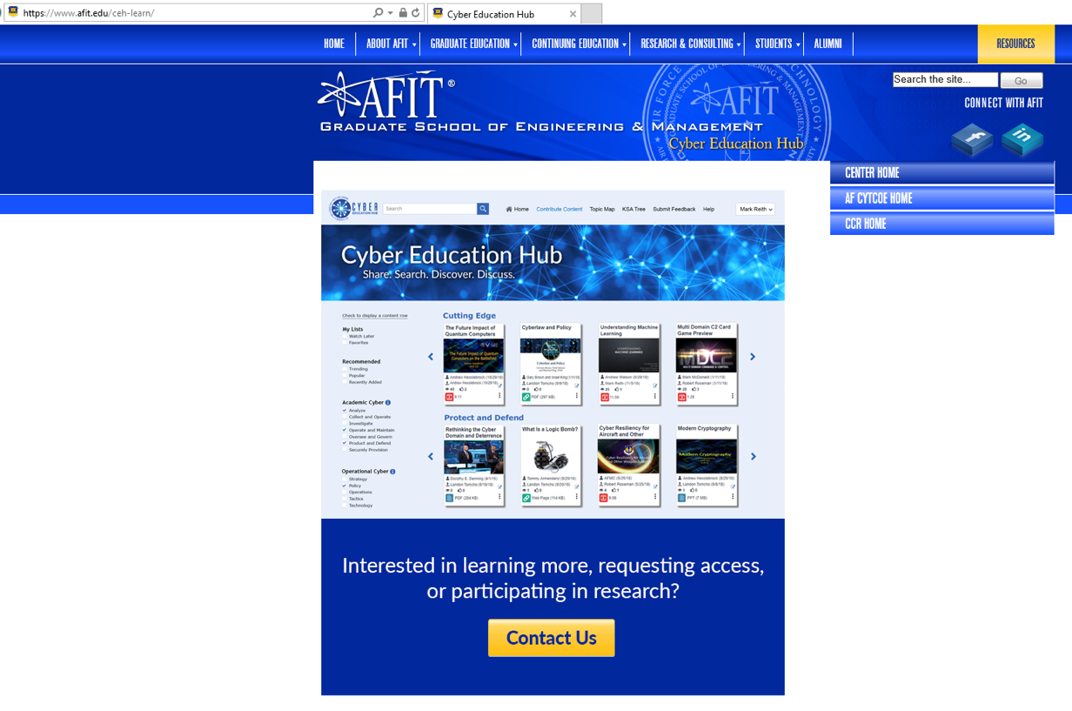
Want to Participate?
https://www.afit.edu/ceh-learn/

Slide 39
BREAK TIME!
Lunch Options?

Slide 40
Multi-Domain Operations
AFCEA Rocky Mountain Cyberspace Symposium
Capt Nathan Flack

Slide 41

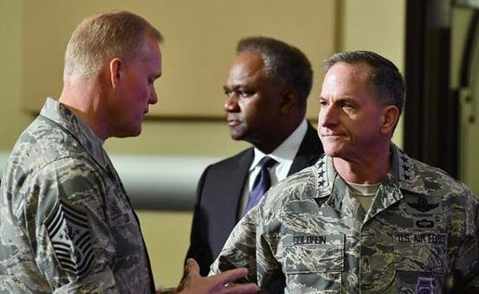
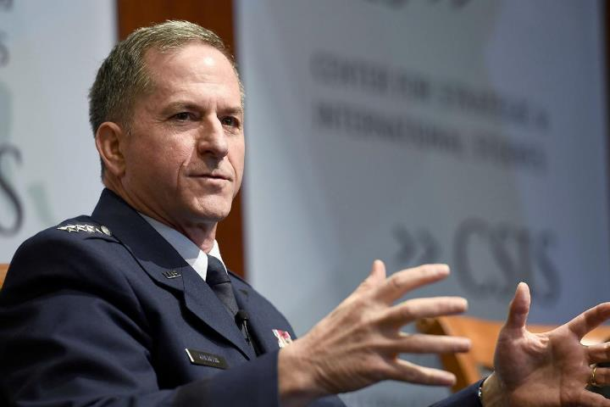
“Achieving a military advantage will depend on harnessing the vast amount of information our sensors can generate, fusing it quickly into decision-quality information, and creating effects simultaneously from any domain, region or command anywhere in the world.”
“Vicious Harmony”
- General David Goldfein
defensenews.com
airforcemag.com
Notes:
CSAF 3rd Focus Area (Mar 2017)
“The changing national security environment also requires us to examine how we sense, decide, and act rapidly and in concert across all domains – or to put it another way, master command and control of the multi-domain battle.
“Linking operations moving at the speed of light with operations moving at the speed of sound required we bring it all together: the skills of our Airmen, the vision of our leaders, and the audacity and technical innovation found throughout Air Force history.”
“This evolution in our command-and-control capabilities required new thinking, new training, and perhaps new technologies or new ways to use older technologies”
Outlook Article: “US Air Force Chief of Staff: Our military must harness the potential of Multidomain operations
It is no overstatement to say that the same kind of intuitive speed in understanding and directing information [of targeted advertisements] is what our military needs in order to win future wars. This new kind of warfare will require us to defend against and attack foes on land and sea as well as in the air, space and cyberspace.
“It is no overstatement to say that the same kind of intuitive speed in understanding and directing information [in targeted advertising] is what our military needs in order to win future wars. This new kind of warfare will require us to defend against and attack foes on land and sea as well as in the air, space and cyberspace.”
Gen David Goldfein

Slide 42
MDC2 Definition
“Visualizing and executing operations with simultaneity and depth through the air, land, sea, space and cyberspace to dislocate the adversary and outpace his ability to respond.”
-- Dr. James Campbell, ACSC Professor
﻿”Achieve integrated awareness of the operational environment to enable rapid discernment of decision-quality information, integrate global and regional capabilities with effective command relationships, and operate with agility and resilience in, from, and through the air, space, and cyberspace.”
-- AFFOR (2015)

Slide 43
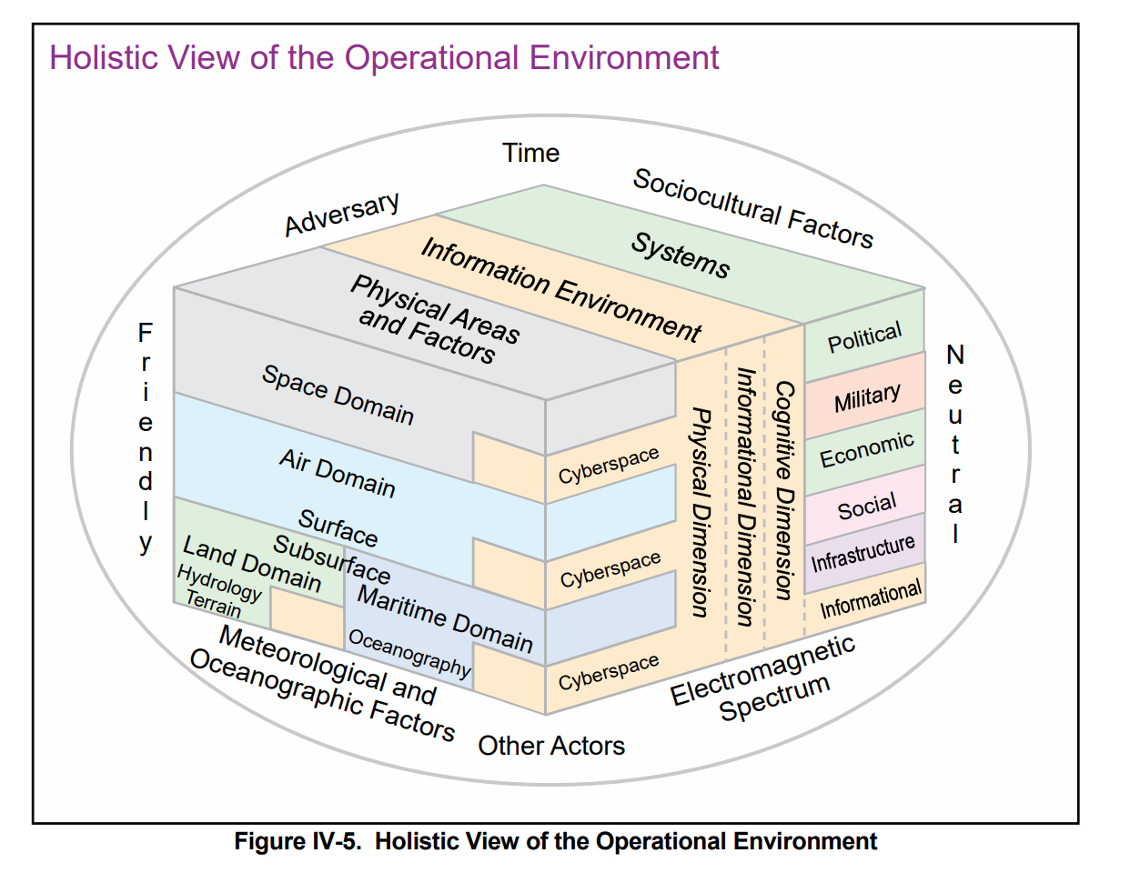
A Complex Problem

Slide 44
Warfighting Domains and Influencers
CIVILIAN SECTOR
ELECTRONIC WARFARE
Cognitive/Human
SPACE
CYBER
INTEL
INFORMATION OPS
MDO Fundamentals:
Agile C2 to gather, synthesize data into actionable information
Disrupt Enemy Cohesion, Disrupt OODA Loop
Battlefield AOR stretched to home station
Conversation must include civilian sector
Space
Air
War-fighting Domains
Cyber
Land
Maritime
Cross-Cutting Sectors

Slide 45
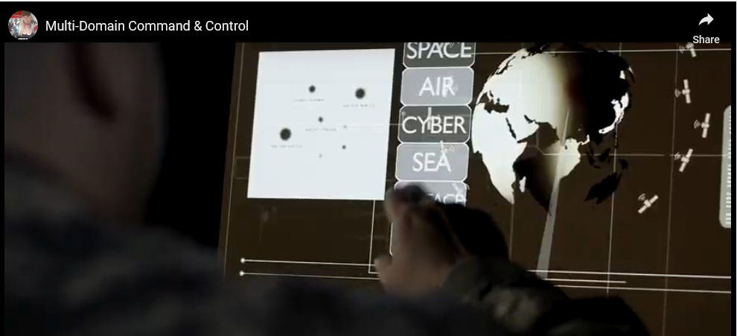
Future MDC2

Slide 46
Current State
CSAF made MDC2 #3 Focus Area in 2017
SECAF highlights need for MDO collaboration and innovation
Vice Chief’s Challenge: “game-changing” MDC2 solutions (Feb 19)
Brig Gen Saltzman led Enterprise Capability Collaboration Team (ECCT)
Integrate MDO into current education and training
Create MDC2 Career Field (13 Oscar) – first tech school class in Aug 19
4-Star C2 Summit (Jan 19), Doolittle Wargames (held annually in Oct)
Army Efforts:
Training and Doctrine Command (TRADOC) MDO Strategy [with AF/Marines]
Multi-Service table-top exercises with AF ACC
Created first MDO detachment (Intel, Info, Cyber, Electronic Warfare, & Space (I2CEWS)

Slide 47
MDC2 Card Game: Overview

Slide 48
MDC2 Card Game: Strategic Investment
Find a partner
Develop your strategy
Build individual decks
Discuss strategies/dependencies/capabilities
Simulate first few rounds of gameplay (practice round)
Reference game instructions as necessary
Remember: Choose starting six cards wisely
Remember: You can have no more than two of the same card in your deck (of 40)

Slide 49
Game On!
Find an opponent
Command your forces to win!
DG: awarded to the winner with highest point spread
If there is a conflict of rules or you don’t know how to play-out a specific scenario, discuss what would happen in a real battle situation
Please ask questions or discuss real-world implications as you play

Slide 50
Discussion/Lessons Learned

Slide 51
Optional Survey (Side B)

Slide 52
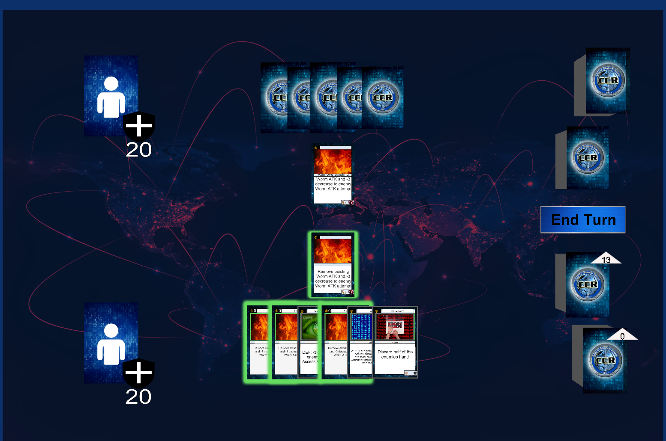
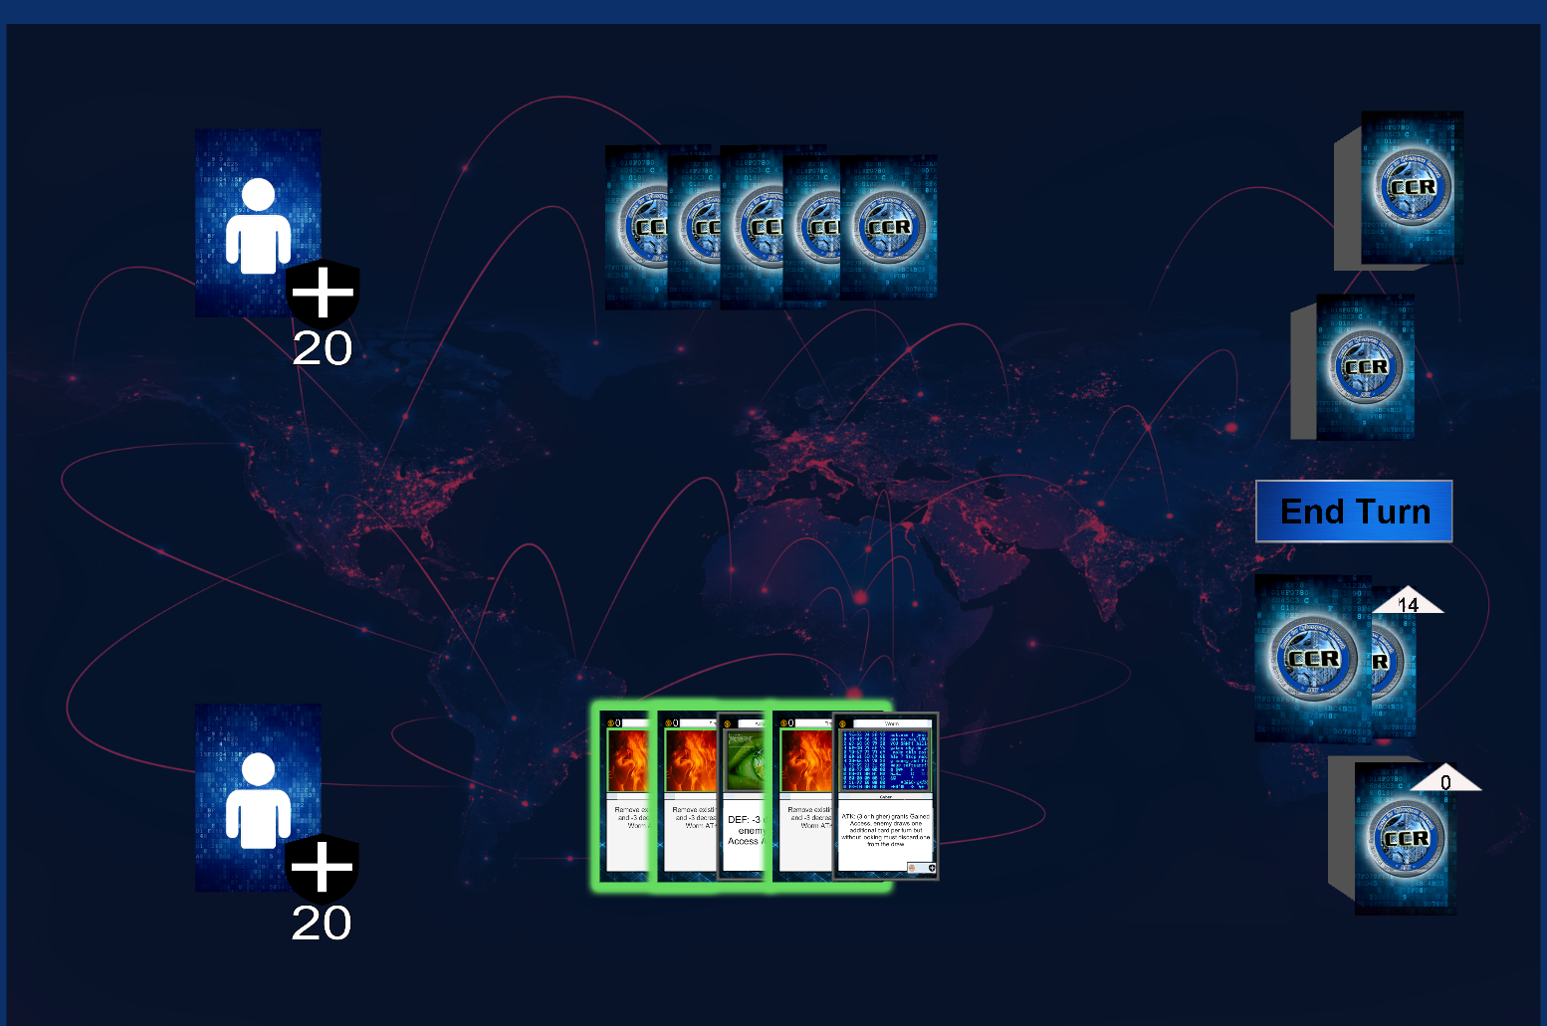
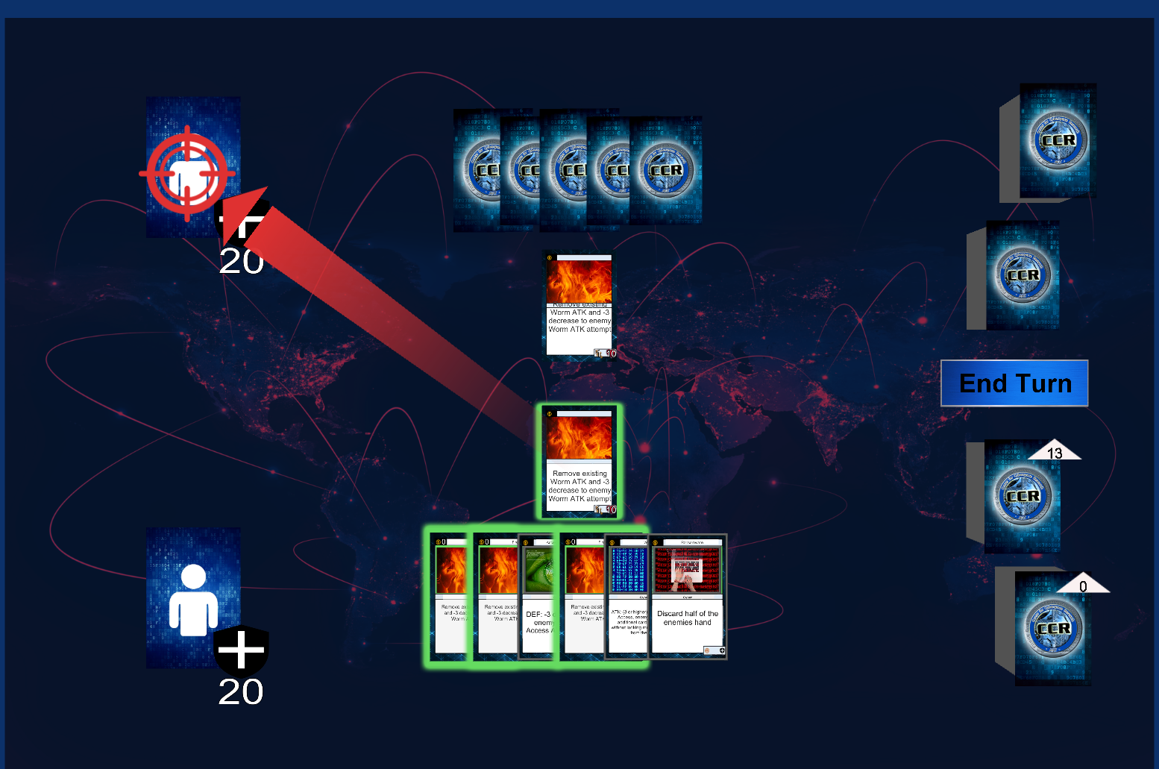
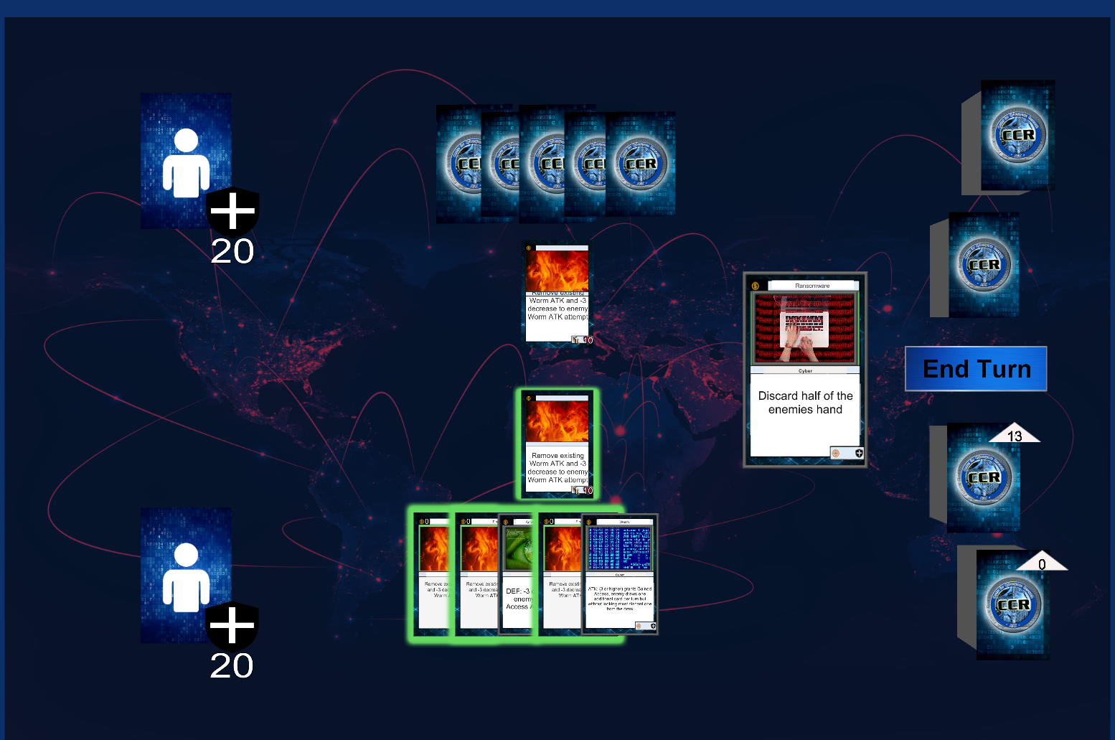
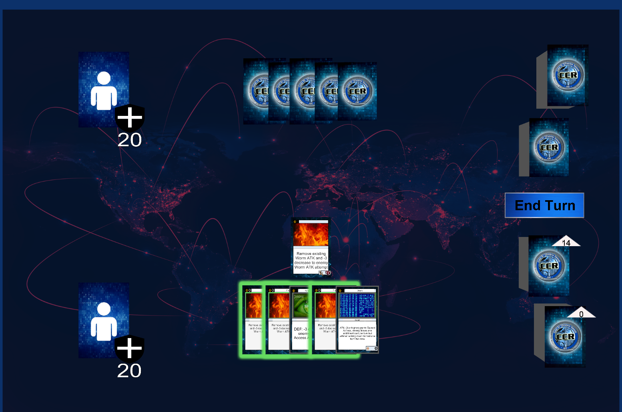
Future Development

Slide 53
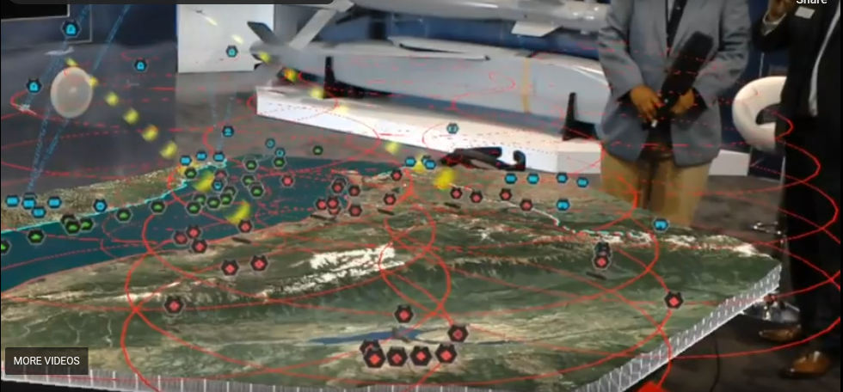
Visualizing a Multi-Domain Conflict

Slide 54
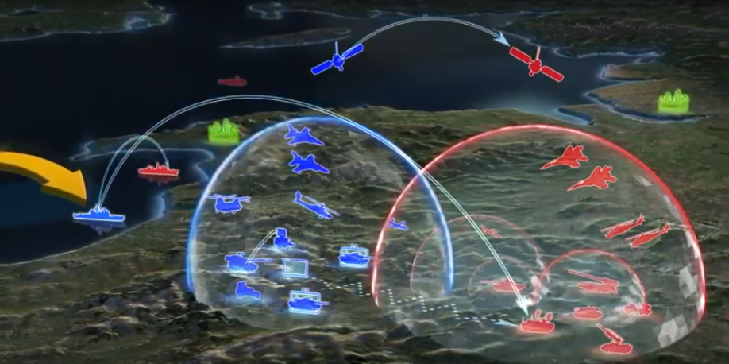
Defensive MDC2?
Remember this?

Slide 55
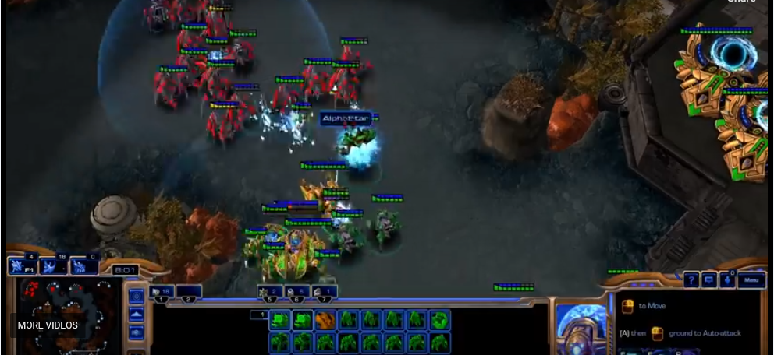
Future MDC2 – Leveraging AI & ML

Slide 56

Additional Notes
Attendance Confirmations
Lunch Options
www.afit.edu/ceh-learn
www.afit.edu/cyber

Slide 57
Videos:
Trailer
https://ceh.aws.solidstatescientific.com/ceh-main/#!playContentItem/0056b822-593b-471b-b42c-98b67c4cd53a&File&Video&Home-Recently%20Added
MDC2 Command and Control Example
https://ceh.aws.solidstatescientific.com/ceh-main/#!playContentItem/43dcf372-bbd4-41e1-b19c-8992b66578c3&Web%20Resource&YouTube&Home-Recently%20Added
Visualizing MDO
https://ceh.aws.solidstatescientific.com/ceh-main/#!playContentItem/9f3fd896-69dd-46e6-a38a-30b530dcc0cd&Web%20Resource&YouTube&Home-Recently%20Added
Skip to 7:35
MDC2 Card Game Demo:
AlphaStar
https://ceh.aws.solidstatescientific.com/ceh-main/#!playContentItem/d9581d8a-6c82-457d-9321-e2c8b5fc5b1e&Web%20Resource&YouTube&Home-Recently%20Added

